Slide 1
Research Agent
IBM PROJECT
Presented By:
Student name : Deepak Kumar
College Name & Department: Delhi Technological University (Mechanical Engineering)

Slide 2
OUTLINE
Problem Statement
Technology used
Wow factor
End users
Result
Conclusion
Git-hub Link
Future scope
IBM Certifications

Slide 3
PROBLEM STATEMENT
A Research Agent AI system designed to assist with academic and scientific research tasks. It can autonomously search for literature, summarize papers, and organize references.
Using natural language processing, it understands research questions and retrieves relevant information. The agent can generate reports, suggest hypotheses, and even draft sections of research papers.
It saves time by automating repetitive tasks like citation management and data extraction. Research Agents enhance efficiency, accuracy, and innovation in both academic and industrial R&D.

Slide 4
TECHNOLOGY USED
IBM Cloud Lite Services
IBM Granite (Large Language Model AI)
Natural Language Processing (NLP)
Data Extraction and Summarization APIs
Automated Citation Management Tools
Custom Workflow Integrations (e.g., document generation, referencing)
Secure Cloud-Based Storage for Document Handling

Slide 5
IBM CLOUD SERVICES USED
IBM Cloud Watsonx AI Studio: A cloud platform for building, training, and deploying AI/machine learning models.
IBM Cloud Watsonx AI Runtime: A managed service to run, serve, and monitor AI models in production environments.
IBM Cloud Agent Lab: A cloud workspace to design, test, and deploy AI-powered agents and automations.
IBM Granite Foundation Model: IBM’s robust family of large language models for generative AI and advanced NLP tasks.

Slide 6
WOW FACTORS
Fully autonomous research workflow from question input to report drafting
Context-aware literature search and instant summarization
Automatic organization of citations and references
Drafting of research paper sections using AI, not just plain text summaries
Time-saving: performs hours of research in minutes
Adaptable to any research domain or academic field

Slide 7
END USERS
Librarians and Information Analysts: Enhance document retrieval and organization
Educators: Develops teaching materials and reference lists
Academics & Researchers: Streamlines literature reviews, reference management, and report drafting
Students: Assists with assignments, thesis preparation, and topic exploration
Industrial R&D Professionals: Accelerates market or technological landscape analysis

Slide 8
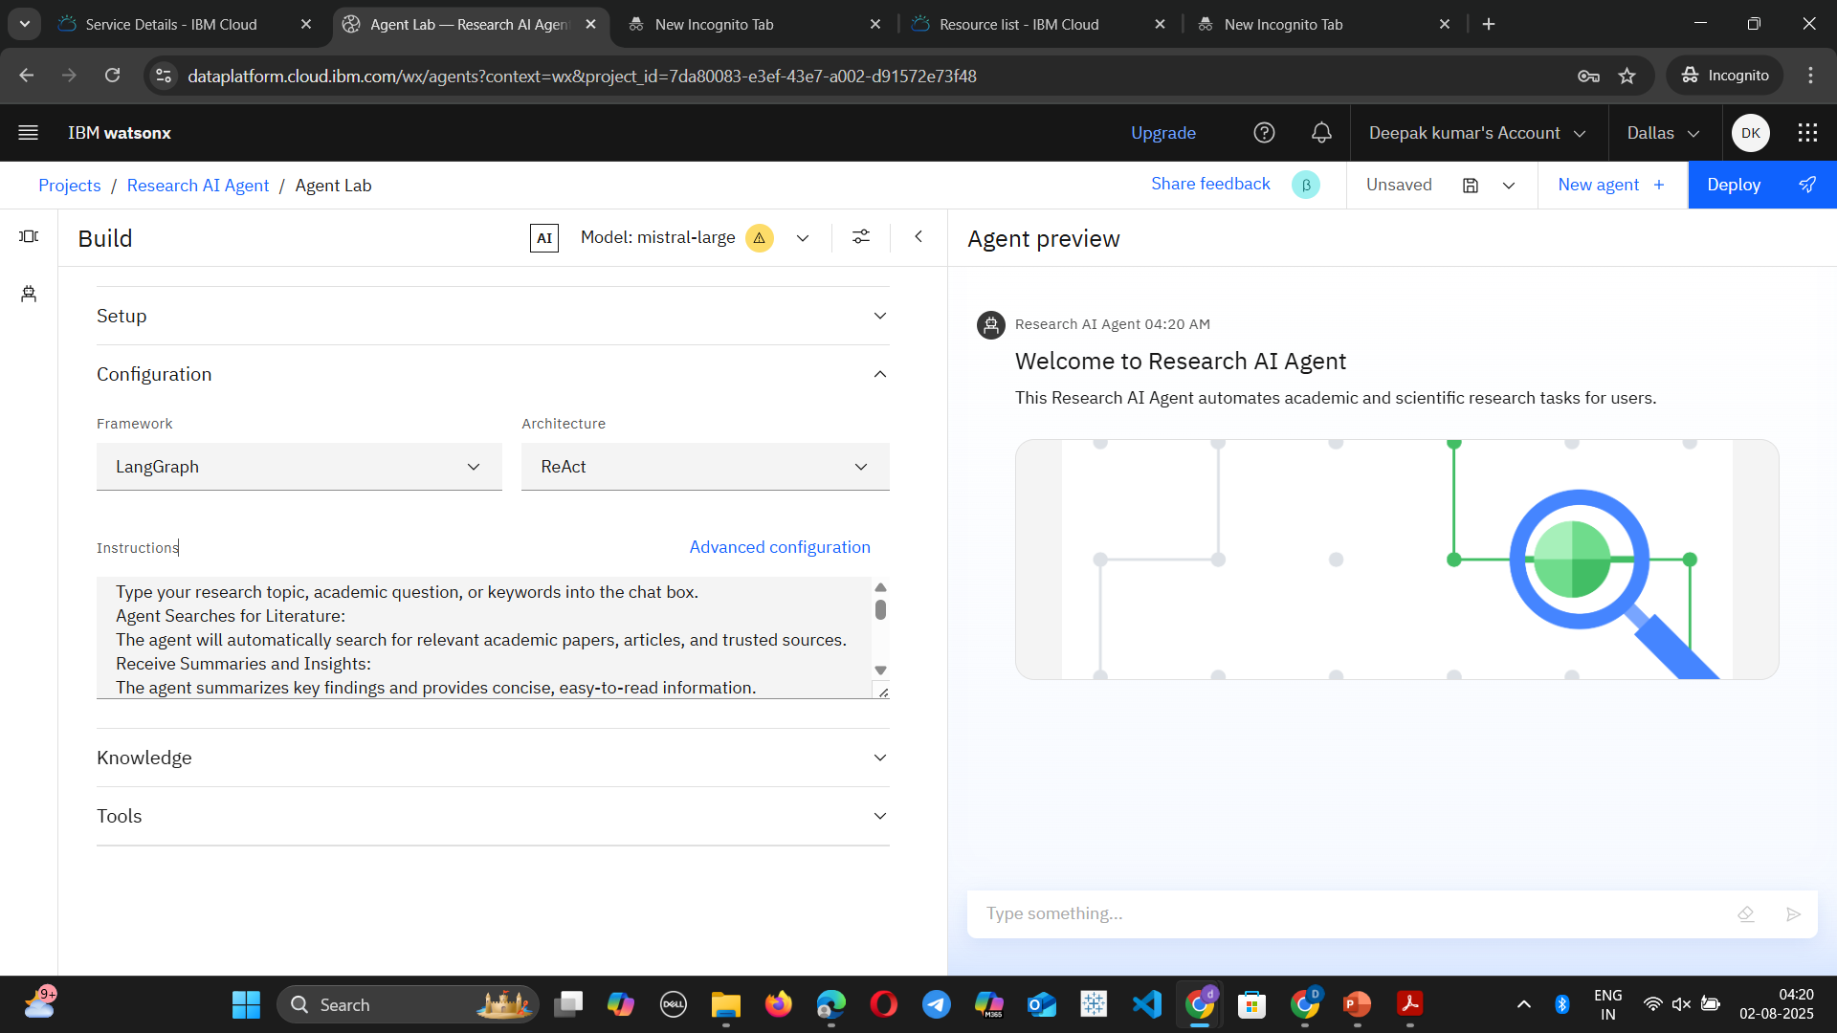
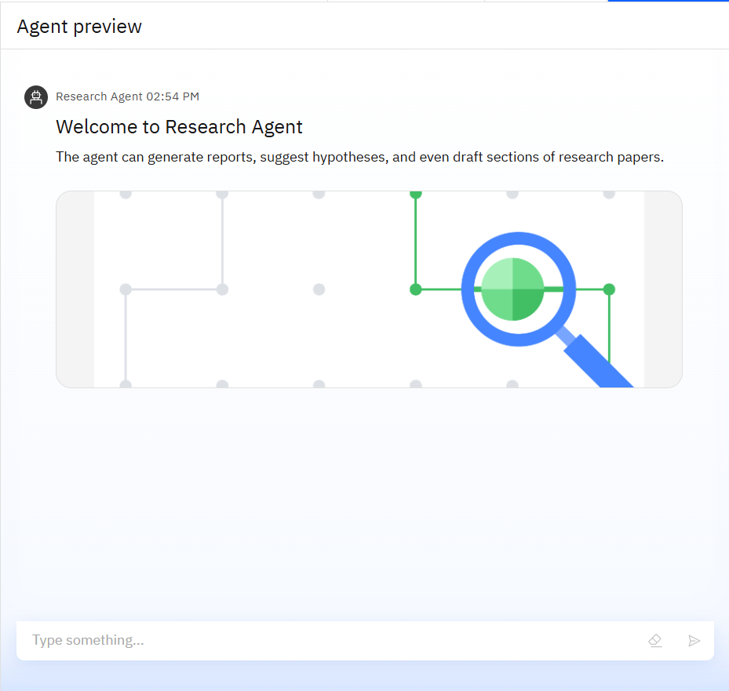
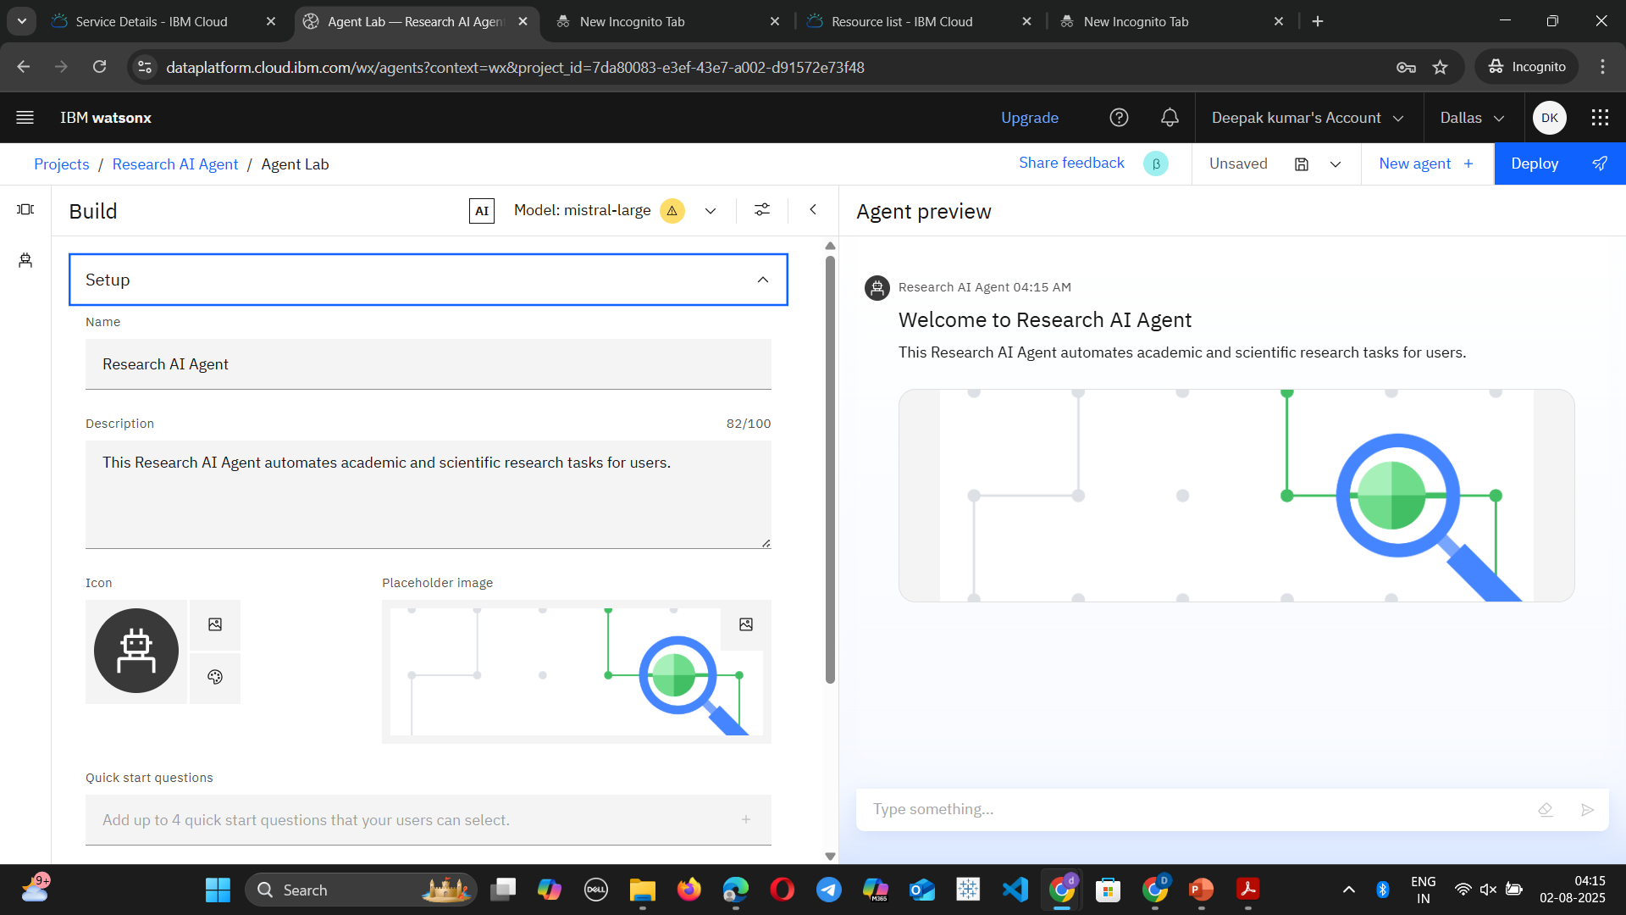
RESULTS

Slide 9
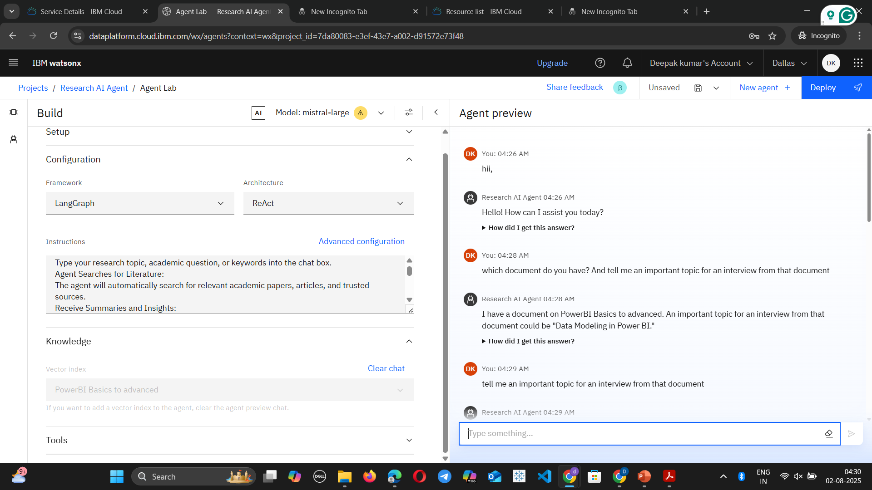
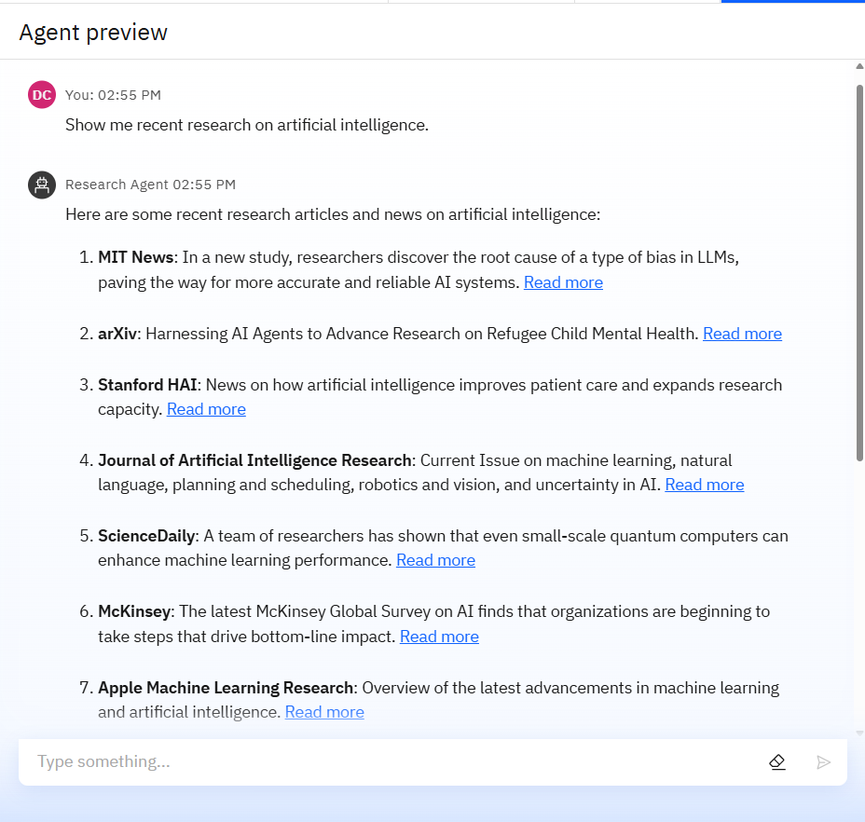
RESULTS

Slide 10
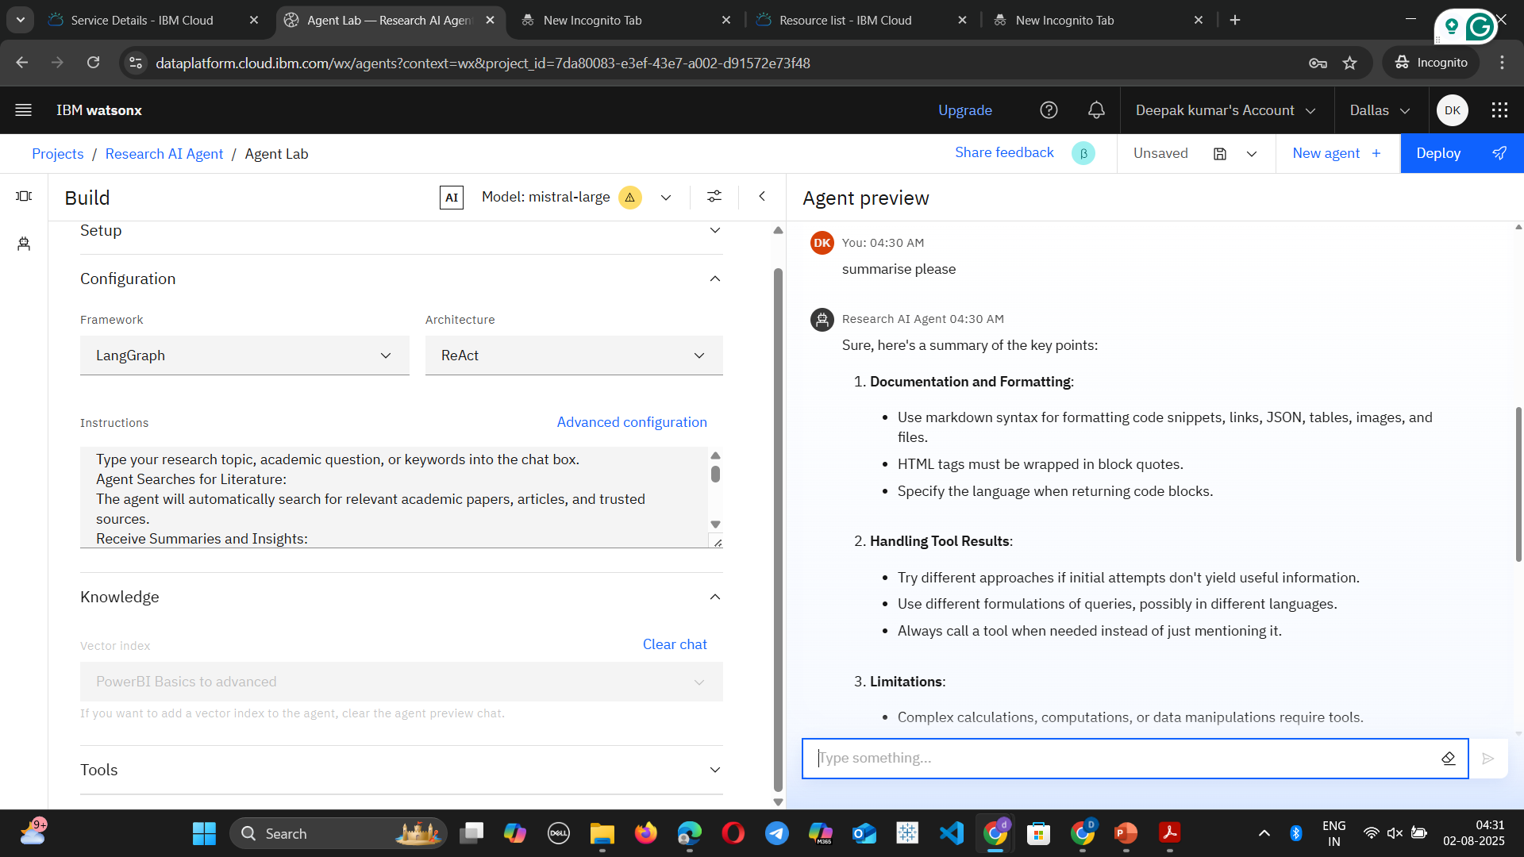
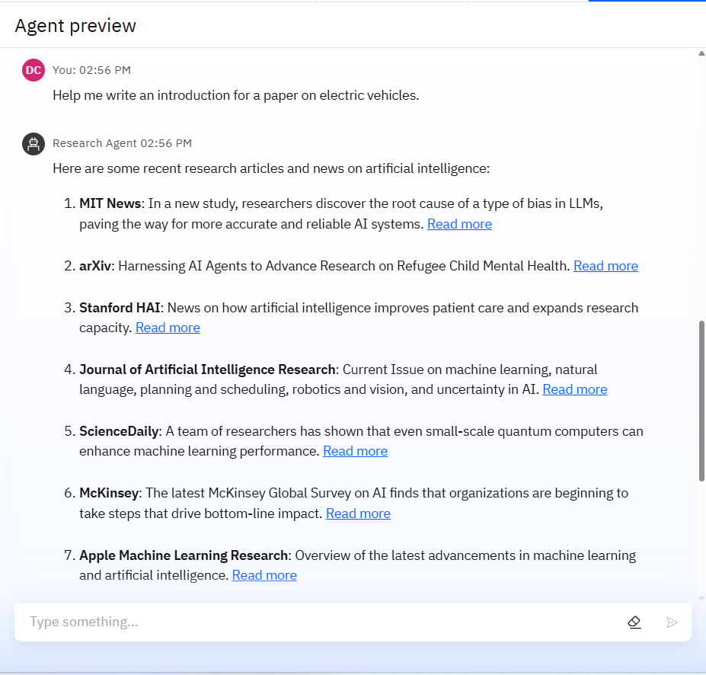
RESULTS

Slide 11
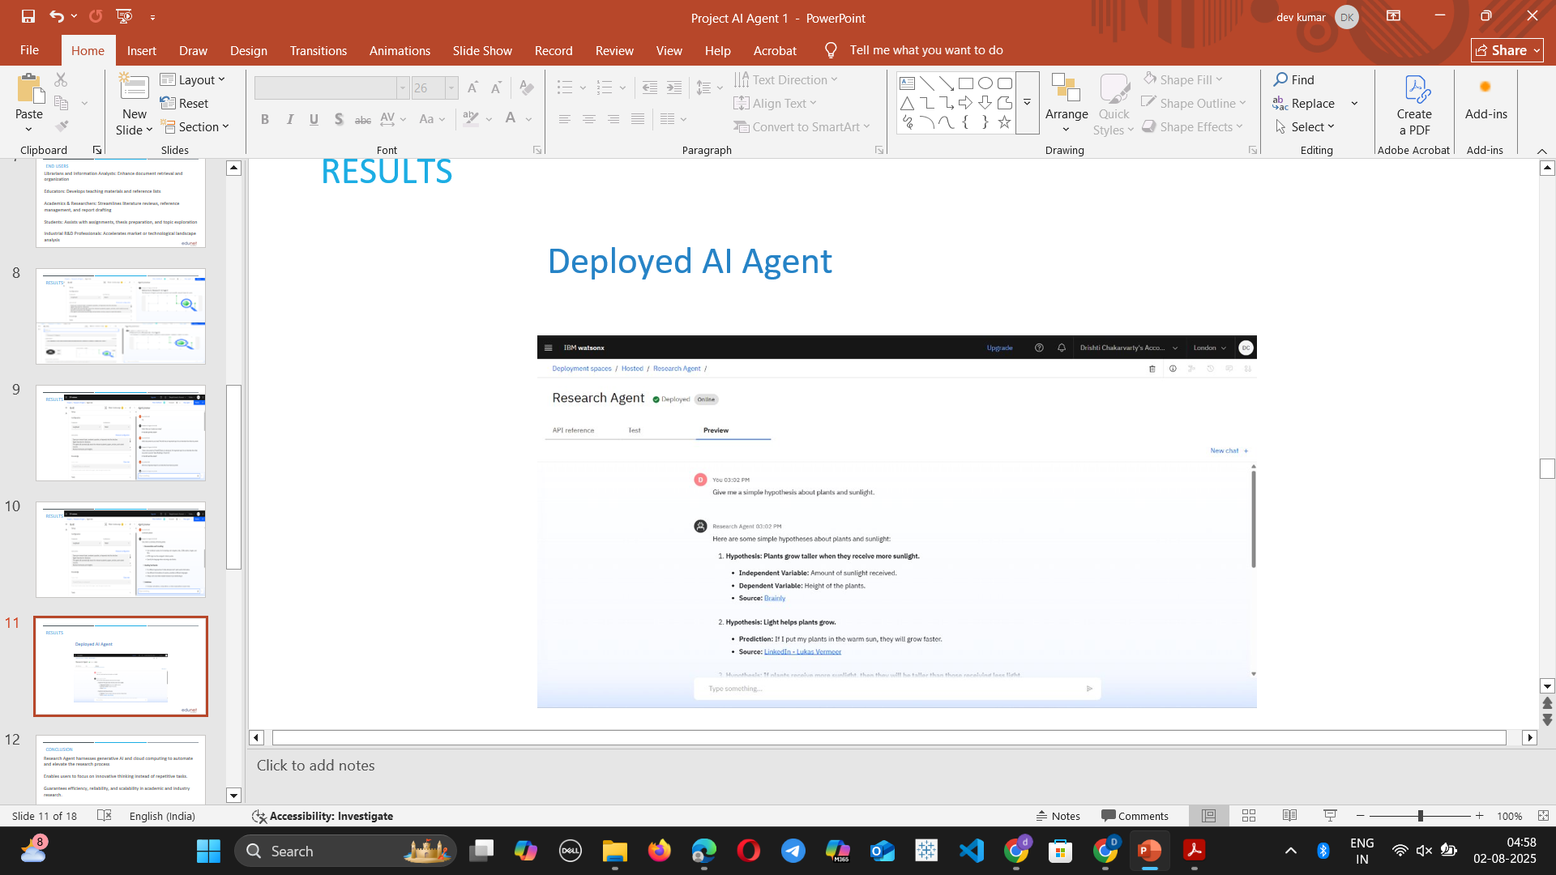
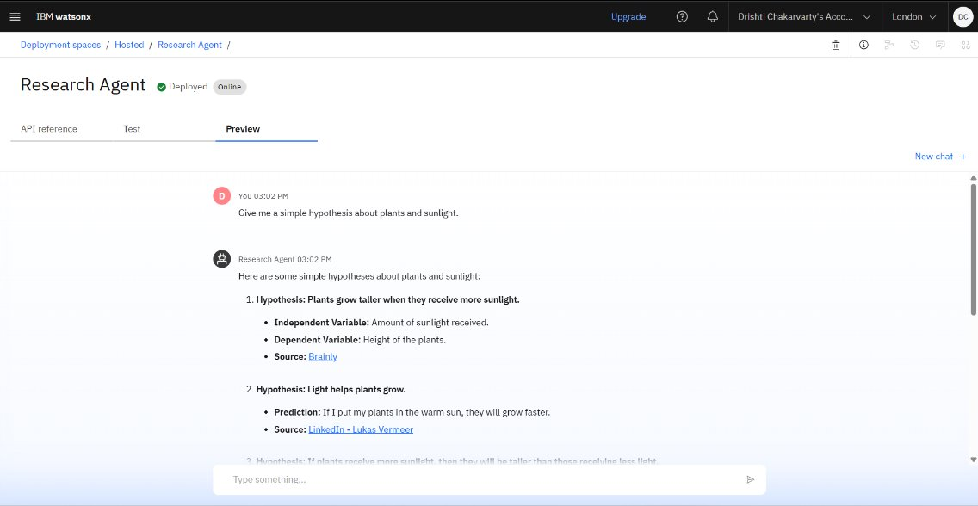
RESULTS
Deployed AI Agent

Slide 12
CONCLUSION
Research Agent harnesses generative AI and cloud computing to automate and elevate the research process
Enables users to focus on innovative thinking instead of repetitive tasks.
Guarantees efficiency, reliability, and scalability in academic and industry research.
Paves the way for new standards in information retrieval, synthesis, and presentation

Slide 13
FUTURE SCOPE
Integration with additional databases (patents, grants, datasets)
Advanced semantic search with voice and image query support
Real-time plagiarism detection and originality assessment
Collaborative features for multi-user research projects
Domain-specific customization (e.g., medical, legal, technical)AI-driven hypothesis generation and experimental design
Multilingual research support for global accessibility

Slide 14
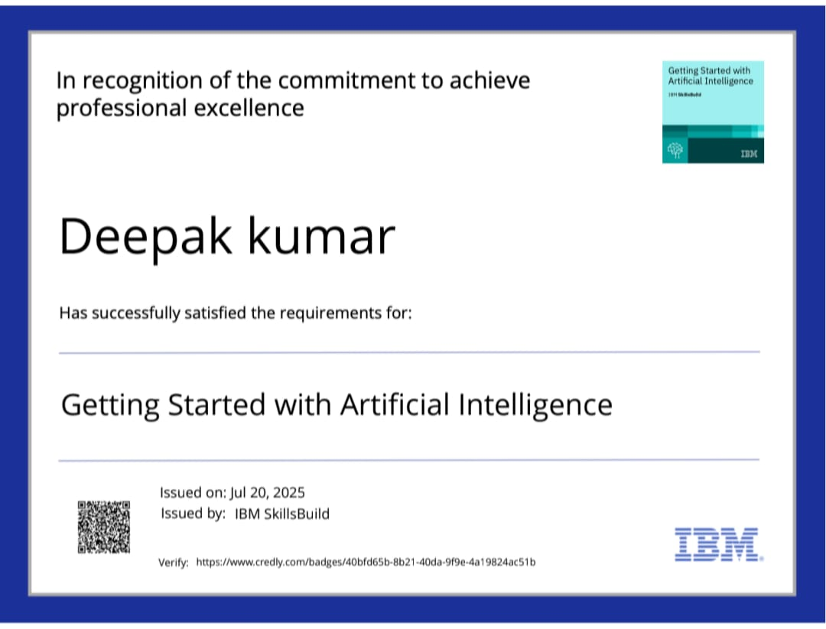
IBM CERTIFICATIONS
Screenshot/ credly certificate( getting started with AI)

Slide 15
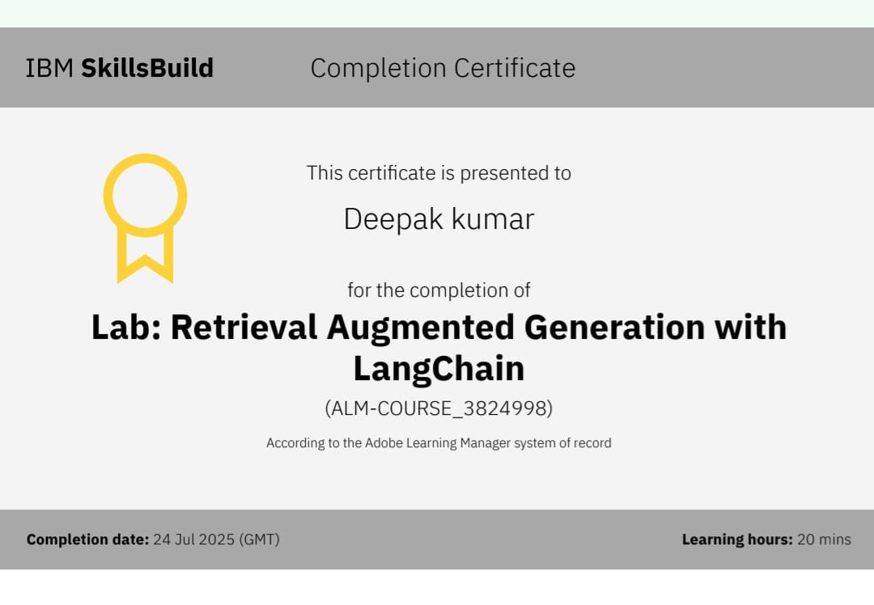
Attach your RAG LAB certificate here

Slide 16
Git hub link :
https://github.com/DeepakKumar682/Research_Agent

Slide 17
THANK YOU

